Slide 1
Interim findings from Severe Obesity Study
Dr Rachel Rowe
Head of UKMidSS

Slide 2
Overview
How does UKMidSS work?
Severe Obesity Study
  Methods
  Control selection quiz!
Interim results
  Response to UKMidSS
  Severe Obesity Study
Conclusions & implications
What’s next?

Slide 3
How does UKMidSS work?
An active reporting and research system
  All alongside midwifery units (AMUs) in UK
  UKMidSS reporters in each AMU
Web-based monthly notification and data collection
  Number of ‘cases’ or ‘nothing to report’
  ‘Denominator data’

Slide 4
UKMidSS data collection
Case reported by email
Data collection on the ‘case’ and one or more ‘controls’
Anonymised information only
  No names, addresses, postcodes, DOB, hospital or NHS numbers
Reporter keeps record of Case ID linked to identifying information

Slide 5
UKMidSS
Severe Obesity Study

Slide 6
Background
Maternal obesity is a recognised risk factor
Lower risks for severely obese multiparous women who are otherwise healthy?
We don’t know how many severely obese women plan AMU birth
No evidence on progress of labour, complications or outcomes for mother and baby

Slide 7
Methods
National cohort study
Objectives
  To investigate outcomes for severely obese women (with BMI>35kg/m²), and their babies, who start labour care in AMUs
    Compare with women of normal weight
  To describe practice across the UK
    How many AMUs admit severely obese women?
    What are the sociodemographic and clinical characteristics of these women?

Slide 8
Data collection
Started 1st January 2016, continues for 12 months
Collecting data about cases…
Any woman with BMI>35kg/m² at booking, who is admitted for labour care to the midwifery unit
and controls…
The two women, with BMI≤35kg/m², admitted to the midwifery unit immediately before the case

Slide 9
Control selection quiz
Why do we collect data about controls?
We want to find out if outcomes for our cases, women with BMI>35kg/m², are different from outcomes for other women
Which other women? Who should we choose as a control?
Other women admitted to the midwifery unit, whose BMI is NOT >35kg/m²
Remember our case definition:
Any woman with BMI>35kg/m² at booking, who is admitted for labour care to the midwifery unit

Slide 10
Control selection quiz
Why can’t we choose the two women who gave birth before the case?
Cases identified from women admitted to midwifery unit for labour care. Some may give birth in the unit, some may be transferred. If you choose women who gave birth in the unit before the case as controls, all controls will have given birth in the unit.
Women who give birth in the unit are not necessarily representative of all women admitted for labour care.
Why can’t we choose another two women admitted to the unit? What about the two women admitted either side of the case?
We want to make sure that controls are representative of women admitted for labour care. Selection by time of admission of case is ‘random’ so likely to be representative.
Problem with choosing controls after case is that the occurrence of a case might affect care for controls. Not likely for this study,
but relevant for next study.

Slide 11
Control selection summary
For the Severe Obesity Study
  Controls should be the two women admitted to the midwifery unit immediately before the case, whose BMI was ≤35kg/m²
  If you have used some other control selection process based on admission to the midwifery unit it’s probably OK, but best to check
  If you have selected controls based on birth in the midwifery unit, please get in touch!

Slide 12
Results

Slide 13
Results overview
January to August 2016
Response to UKMidSS
  Monthly reporting
Cases reported with complete data
  Characteristics of women
  Outcomes
    Transfer
    Use of water during labour and birth
    Mode of birth
  All by parity

Slide 14
Response to UKMidSS
All 122 AMUs across the UK contributing data
Response to monthly reporting emails
  100% of units have submitted at least one monthly report
  90% response overall
  Some variation

Slide 15
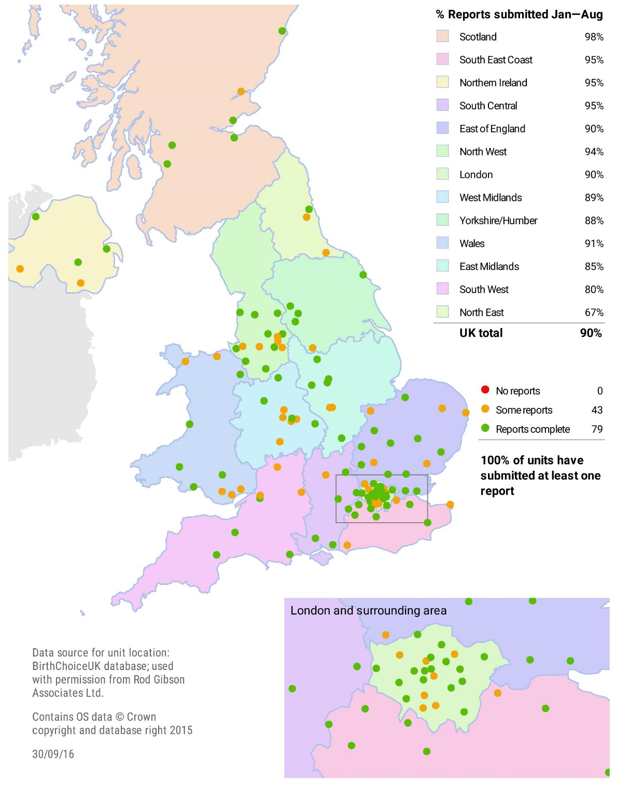
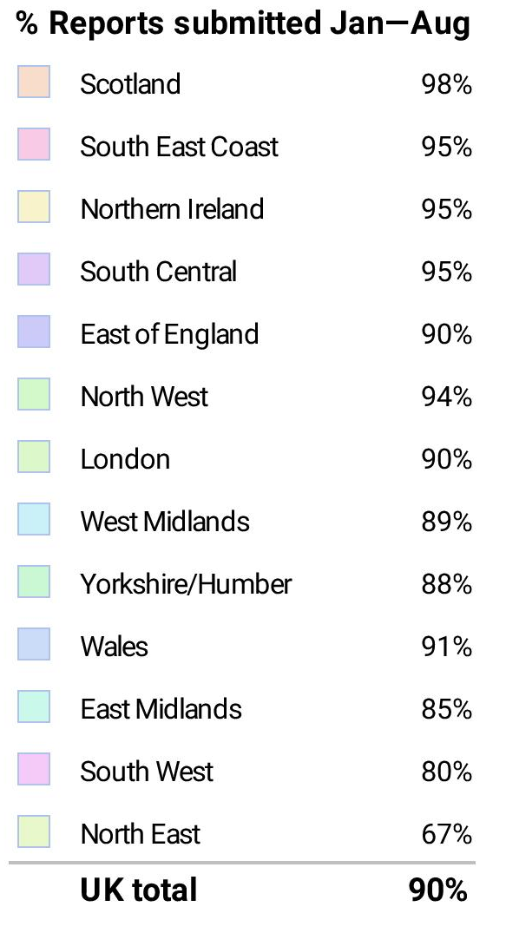
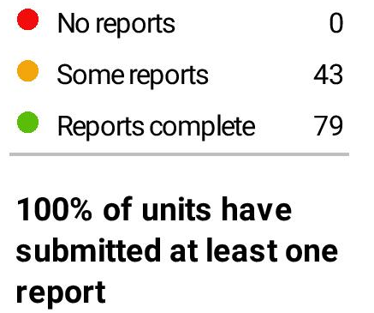
86% of units have submitted reports for at least eight months

Slide 16
Cases reported Jan-Aug 2016
93 units (76%) reported at least one case
Range 1-50 cases per unit
In total, over 8 months, 766 cases
Interim results
  409 cases with complete data
  Reported by 59 units

Slide 17
Characteristics of women: parity
42
27% having first baby
27
20
11

Slide 18
Characteristics of women: BMI
BMI range
35.1-56.7 kg/m²
93% BMI 35.1-40
Any differences by parity?
42
27
20
11

Slide 19
Characteristics of women
 | Nulliparous n=110 % | Multiparous n=297 %
BMI (kg/m²)
35.1-40.0 | 91.8 | 93.3
>40 | 8.2 | 6.8
Maternal age
Under 20 | 8.2 | 1.0
20-24 | 27.3 | 15.8
25-29 | 39.1 | 38.1
30-34 | 20.0 | 32.0
35-39 | 5.5 | 10.8
40+ | 0.0 | 2.4
BMI varies little by parity
Expected differences in age
Multiparous women older

Slide 20
Characteristics of women
Higher proportion of multiparous women smoked during pregnancy
 | Nulliparous n=110 % | Multiparous n=297 %
Ethnic group
White | 88.2 | 83.2
Asian | 0.9 | 5.7
Black | 3.6 | 7.1
Other | 6.4 | 3.0
Smoking status
Non-smoker | 87.2 | 78.2
Smoker | 12.8 | 21.8

Slide 21
Characteristics of women
 | Nulliparous n=110 % | Multiparous n=297 %
Gestation
36-37 | 7.3 | 4.8
38 | 13.8 | 8.8
39 | 17.4 | 23.1
40 | 36.7 | 37.8
41-2 | 24.8 | 25.5
Risk factors*
None | 79.1 | 63.9
One or more | 20.9 | 36.1
Higher proportion of multiparous women had additional risk factors
* Pre-existing risk factors in addition to BMI

Slide 22
Outcomes
Almost half of nulliparous women transferred
Similar proportions used immersion in water and gave birth in water
Almost all multiparous women had spontaneous vaginal birth
 | Nulliparous n=110 % | Multiparous n=297 %
Transfer during labour or soon after birth
 | 48.2 | 11.5
Used immersion in water during labour
 | 32.7 | 27.8
Gave birth in water
 | 16.4 | 18.6
Mode of birth
Spontaneous vaginal | 71.8 | 97.3
Instrumental | 16.4 | 0.7
Caesarean | 11.8 | 1.7

Slide 23
Conclusions and implications
Admission of severely obese women to AMUs is widespread
High proportions have good outcomes in terms of mode of birth
Almost half of nulliparous women transfer
Further analyses will investigate outcomes for women and their babies in more detail

Slide 24
What’s next?
Data collection for Severe Obesity Study continuing until 31st December 2016
  Last report request for Severe Obesity Study on 1st January 2017
Big effort to get all monthly reports in and data on cases and controls entered
Checking missing data and queries
Analysis, write-up & publication
Next study starting…

Slide 25
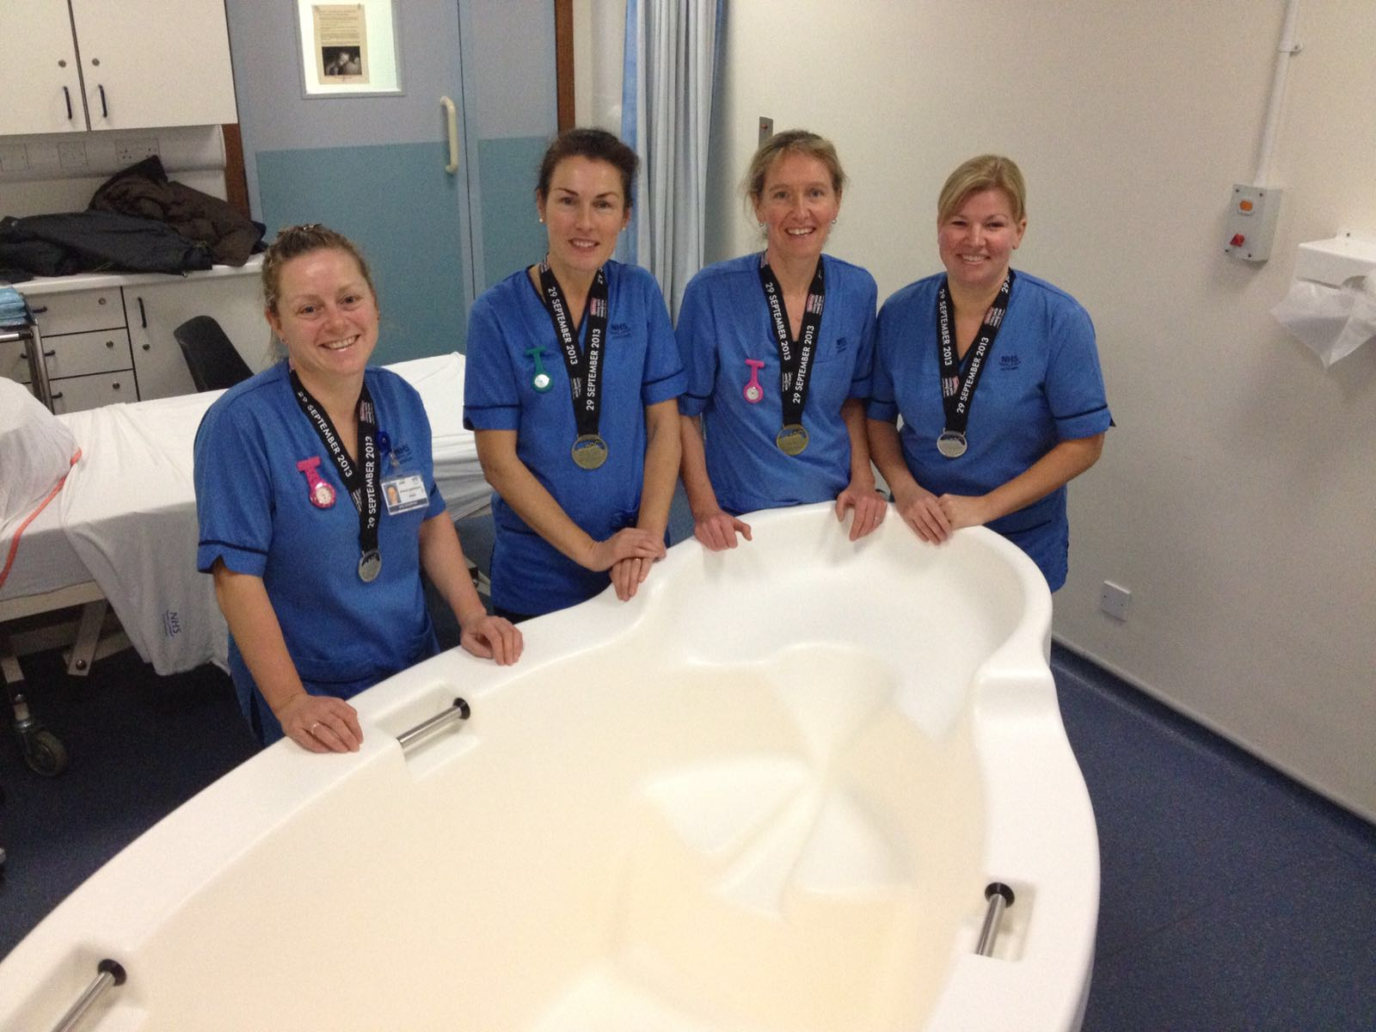
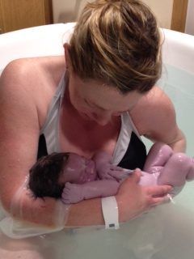
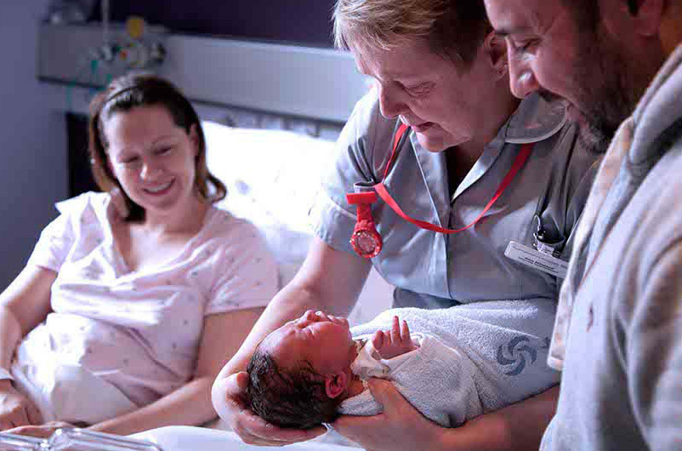
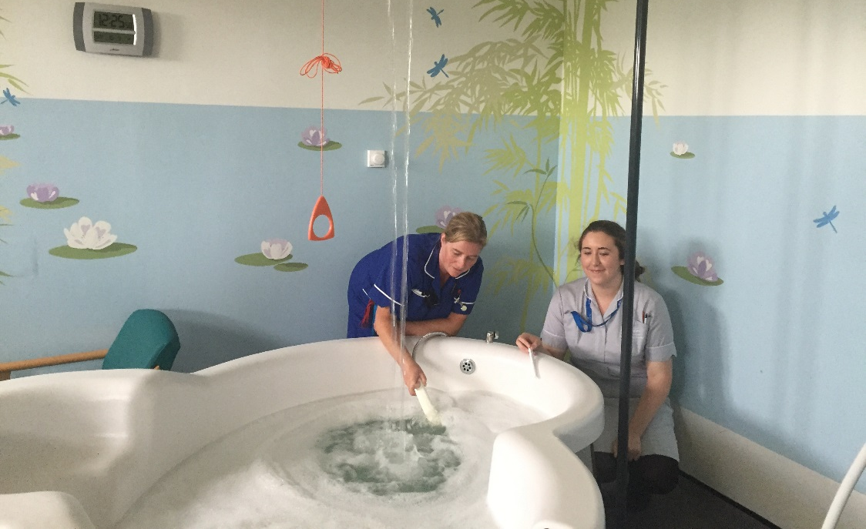

Slide 26

Thank you!
Any questions or comments?
ukmidss@npeu.ox.ac.uk
https://www.npeu.ox.ac.uk/ukmidss
@NPEU_UKMidSS
This is independent research arising from a National Institute for Health Research (NIHR) Post Doctoral Fellowship awarded to Rachel Rowe (PDF-2014-07-006). The views expressed are those of the author and not necessarily those of the NHS, the NIHR or the Department of Health.

