Slide 2
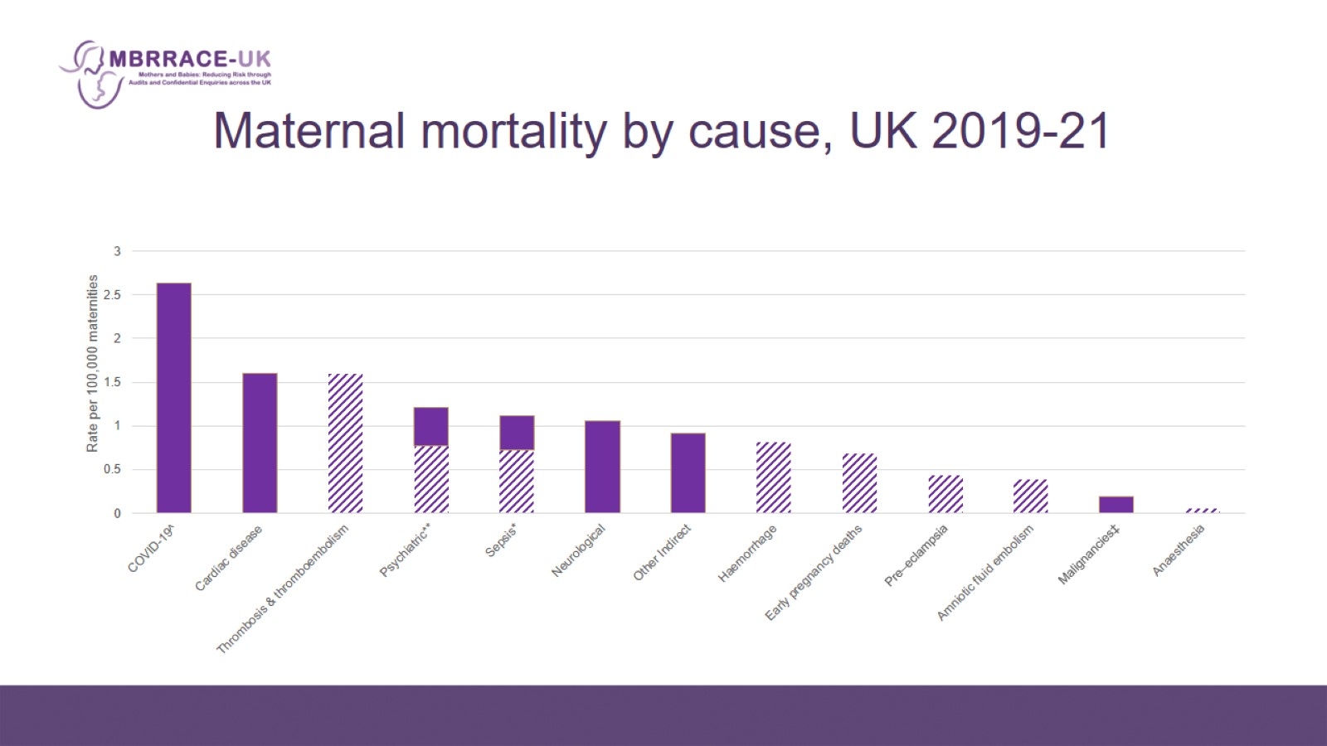
Maternal mortality by cause, UK 2019-21

Slide 5
Vaccination uptake

Slide 6
What could have been done better?

Slide 7
Vaccines in pregnancy

Slide 8
Vignettes

Slide 9
Vignette

Slide 10
‘At the moment I’m counting women dying every week’. Marian Knight, Nov 21, BMJ

Slide 11
ITU admissions with Covid

Slide 12
Recommendations

Slide 13
Recommendations

Slide 14
Lessons - access to vaccines

Slide 15
REMEMBER Vaccination is safe in pregnancy – covid and flu are not

Slide 16
Recommendations

Slide 17
Vignette

