Slide 2
Demographics

Slide 3
Substance Misuse

Slide 4
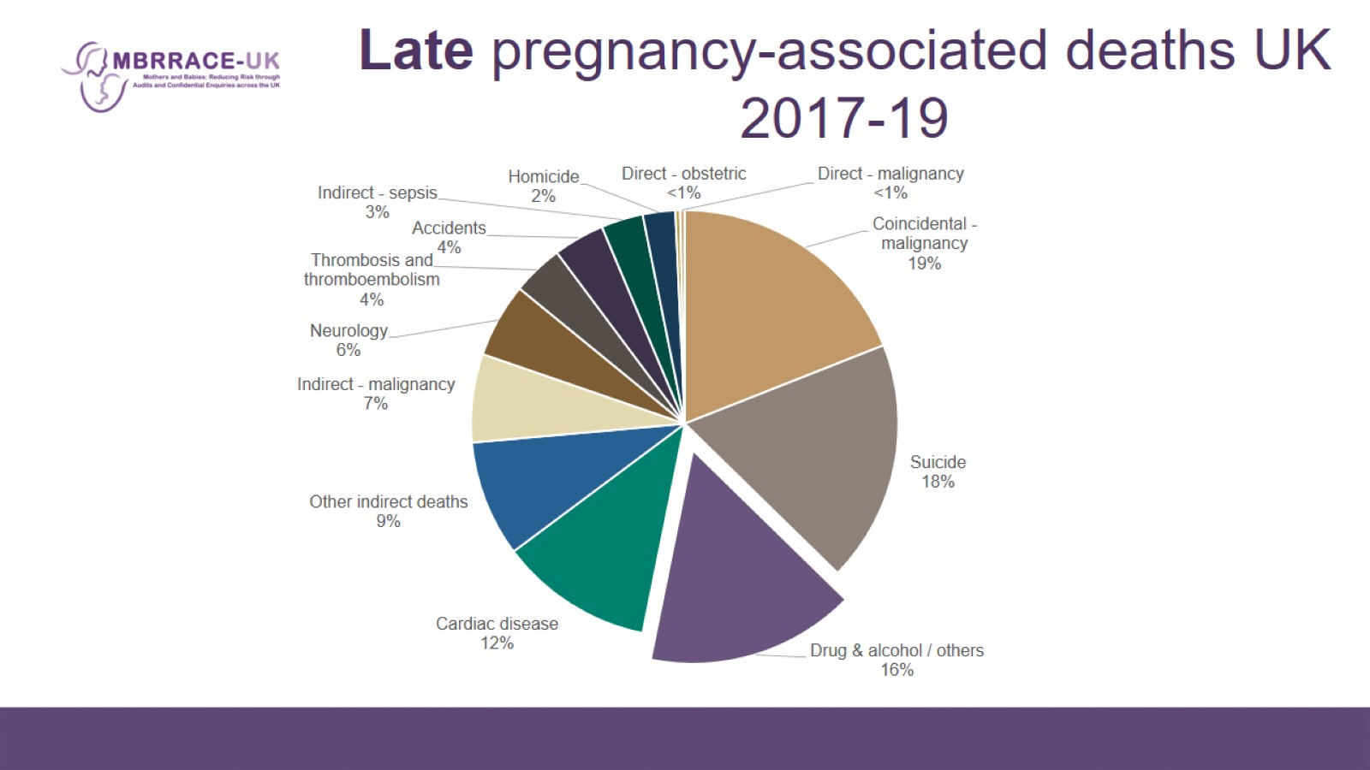
Late pregnancy-associated deaths UK 2017-19

Slide 5
Timing of deaths from substance misuse

Slide 6
Substance Misuse

Slide 7
Vignette

Slide 8
Vignette

Slide 9
Substance Misuse

Slide 10
Substance Misuse

Slide 11
Loss Events

Slide 12
Previous Learning Point

Slide 13
Learning Point

Slide 14
Domestic Abuse

Slide 15
Homicide

Slide 16
Vignette

Slide 17
Homicide

Slide 18
Learning Point

Slide 19
Complex Adversity

Slide 20
Vignette

Slide 21
Complex Adversity

Slide 22
Learning Point

Slide 23
Classification of Care

