Slide 2
Saving Lives, Improving Mothers’ Care

Slide 3
Maternal Morbidity and Mortality Annual Report Topic Cycle

Slide 4
MBRRACE-UK: METHODS

Slide 5
Reporting of maternal deaths - UK

Slide 6
MBRRACE–UK Methods

Slide 7
Confidential Enquiry Assessors

Slide 8
Maternal Deaths - Definitions

Slide 9
Presentation of results

Slide 10
MBRRACE-UK: SURVEILLANCE RESULTS

Slide 11
The women who died 2017-19

Slide 12
Maternal mortality UK 2003-19

Slide 13
Maternal mortality UK 2003-17

Slide 14
Causes of maternal death 2017-19

Slide 15
Direct Maternal Deaths 2017-19

Slide 16
Direct Maternal Deaths 2017-19

Slide 17
Late pregnancy-associated deaths UK 2009-19

Slide 18
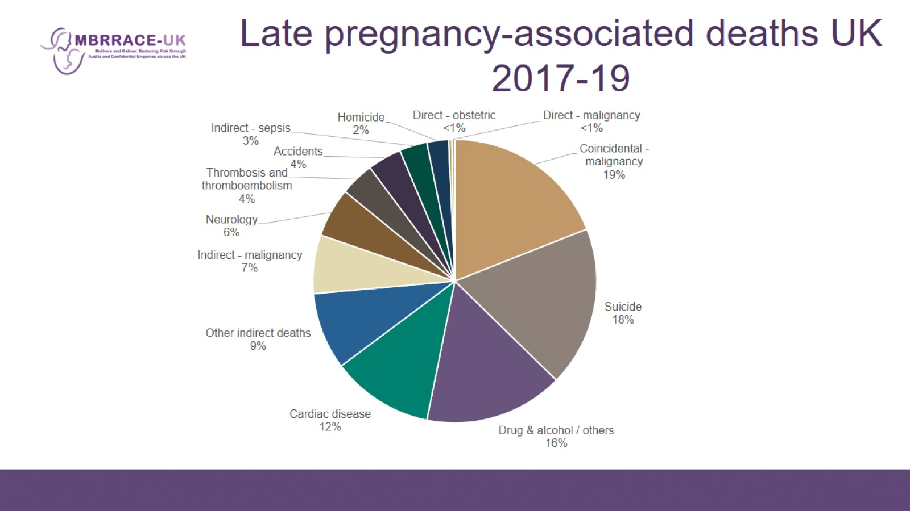
Late pregnancy-associated deaths UK 2017-19

Slide 19
Late maternal deaths UK 2017-19

Slide 20
Indirect Maternal Deaths 2017-19

Slide 21
Indirect Maternal Deaths 2017-19

Slide 22
Ethnic disparities

Slide 23
Mortality rates amongst different population groups 2017-19

Slide 24
Maternal mortality rate according to country of birth

Slide 25
Inequalities 2016-18 versus 2013-15

Slide 26
Area of residence

Slide 27
Severe and multiple disadvantage* among women who died 2017-19

Slide 28
Other characteristics of women who died

Slide 29
Overall assessment of care

Slide 30
Maternal Mortality in the UK

Slide 31
Maternal Mortality in the UK

Slide 32
Republic of Ireland: MMR

Slide 33
Direct and Indirect MMR per 100,000 maternities in ROI 2009-2019

Slide 34
Comparison of MMR: Republic of Ireland & UK 2017-2019

Slide 35
Actions following previous reports

Slide 36
Actions following previous reports

Slide 37
Actions following previous reports

Slide 38
Actions following previous reports

Slide 39
SUMMARY

Slide 40
Key messages - 1

Slide 41
Key messages - 2

Slide 42
Acknowledgements

