Slide 2
Mortality rates for organisations

Slide 3
Mortality rates for organisations

Slide 4
Mortality rates for organisations

Slide 5
Mortality rates for organisations

Slide 6
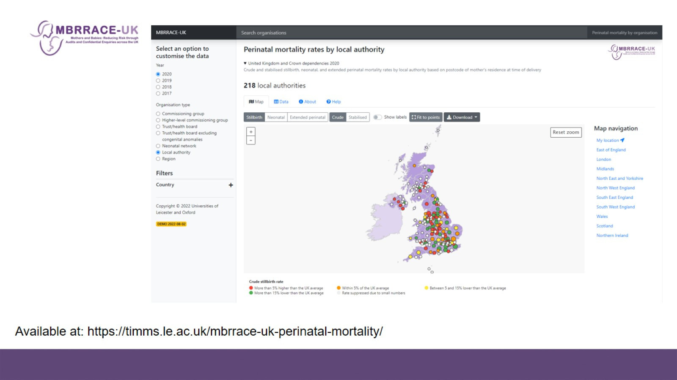

Slide 9
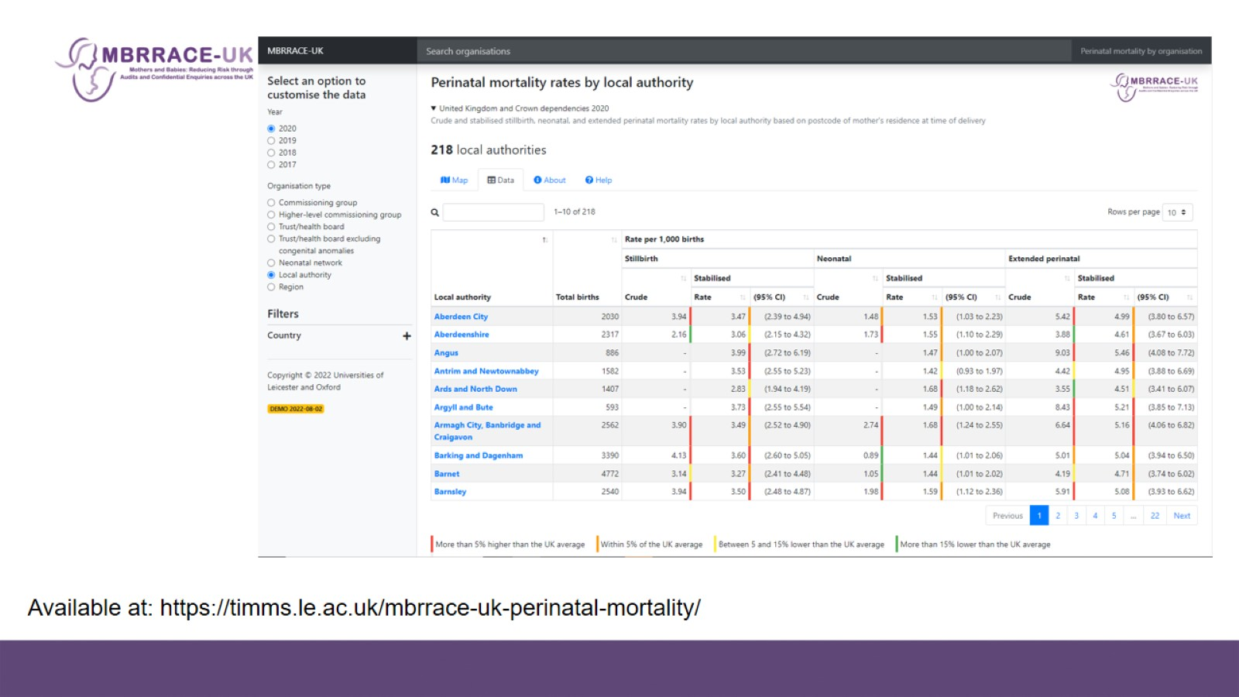

Slide 10
Reports to organisations delivering maternal or neonatal care

Slide 11
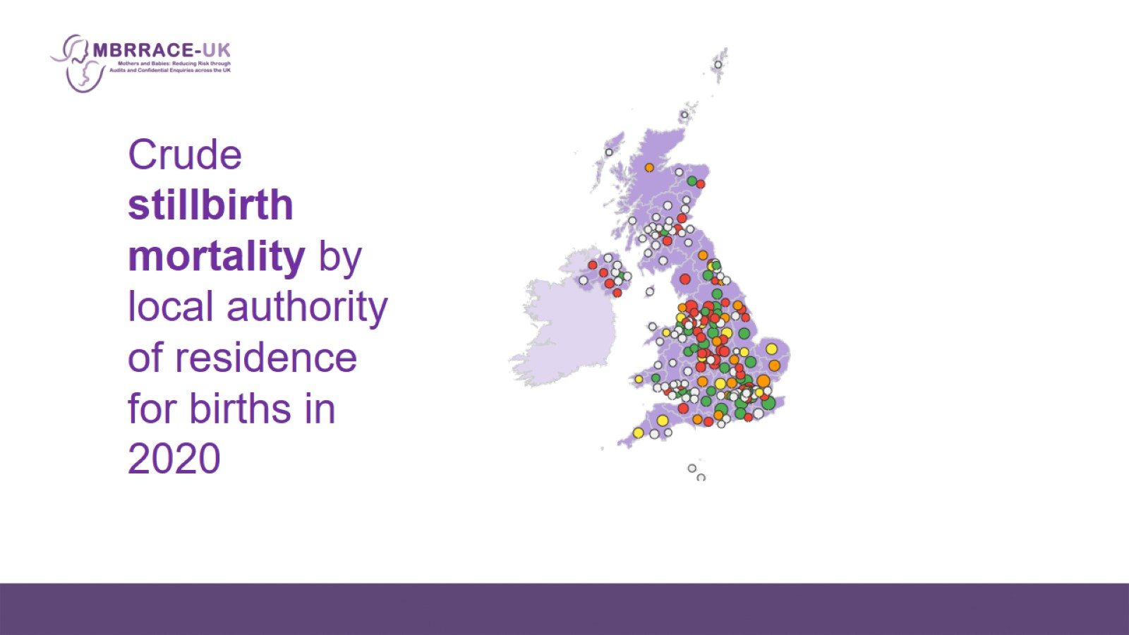

Slide 30
Thank you

