Slide 2
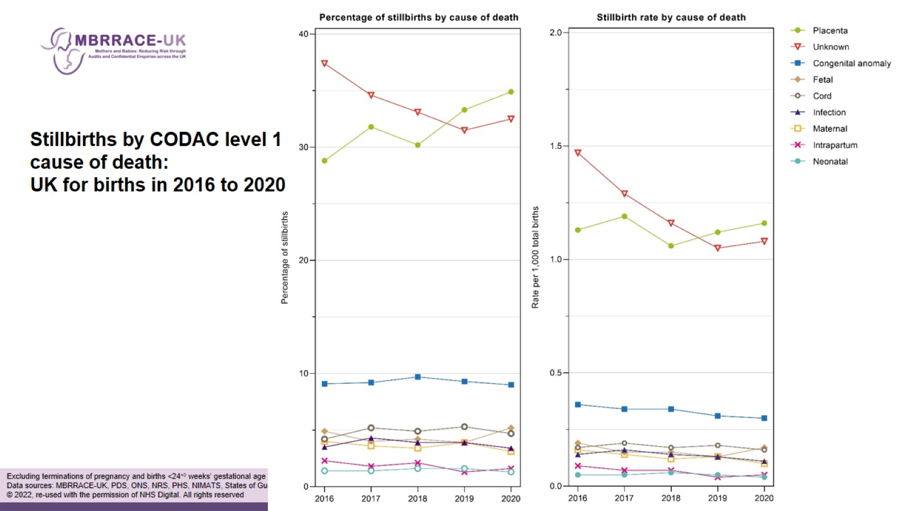

Slide 4
Causes of perinatal death

Slide 5
Causes of perinatal death

Slide 6
Causes of perinatal death

Slide 9
Causes of perinatal death

Slide 10
Causes of perinatal death

Slide 11
Causes of perinatal death

Slide 12
Causes of perinatal death

Slide 13
Causes of perinatal death

Slide 14
Further work to improve classification of SBs and NNDs

Slide 15
Now into Phase 2 of development

