Slide 2
Background from Twin Confidential Enquiry

Slide 3
Effect of twin pregnancy on perinatal mortality - stillbirths

Slide 4
Effect of twin pregnancy on perinatal mortality - stillbirths

Slide 5
The gap between singleton and twin mortality rates is widening

Slide 6
Effect of twin pregnancy on perinatal mortality – neonatal deaths

Slide 7
Effect of twin pregnancy on perinatal mortality – neonatal deaths

Slide 8
The gap between singleton and twin mortality rates is widening

Slide 9
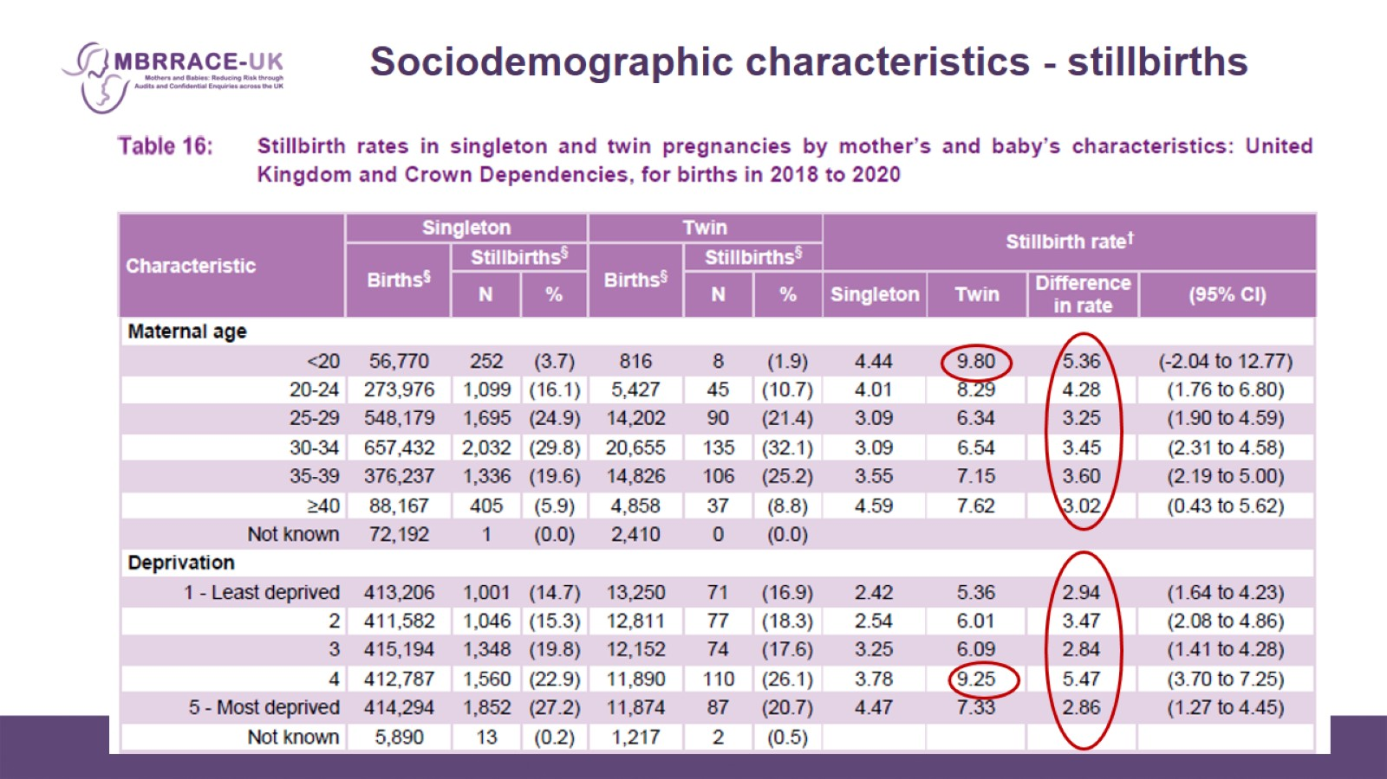
Sociodemographic characteristics - stillbirths

Slide 10
Baby characteristics - stillbirths

Slide 11
Baby characteristics – stillbirths 2

Slide 12
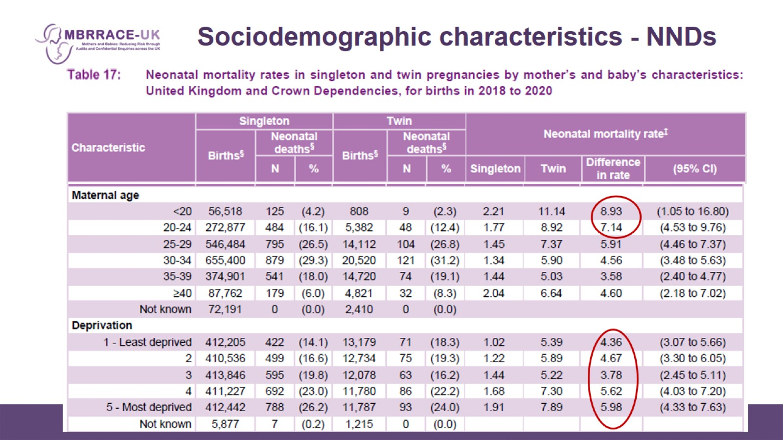
Sociodemographic characteristics - NNDs

Slide 13
Baby characteristics - NNDs

Slide 14
Baby characteristics – NNDs 2

Slide 15
Effect of twin pregnancy on perinatal mortality

Slide 16
Effect of twin pregnancy on perinatal mortality

