Slide 4
Data for denominators and validation

Slide 7
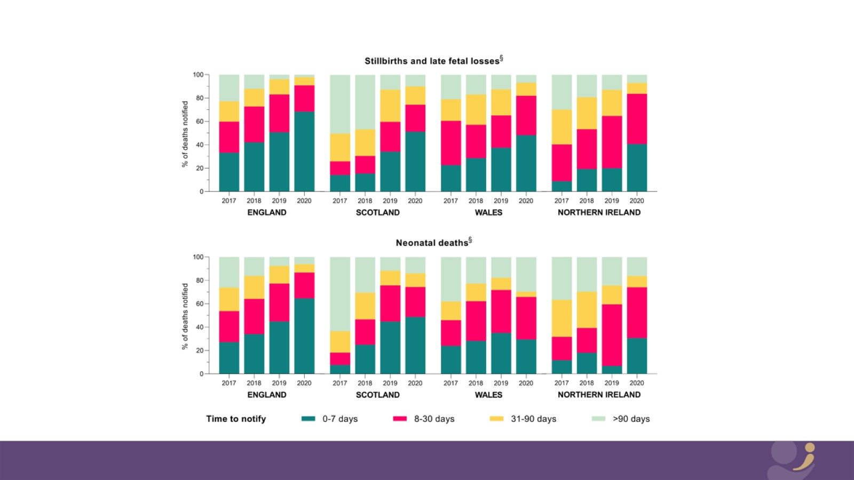

Slide 10
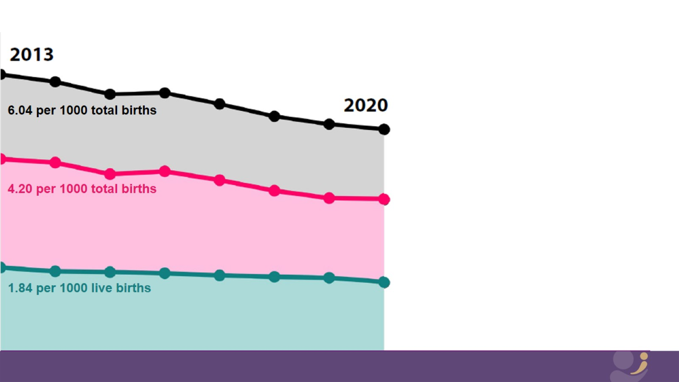

Slide 11
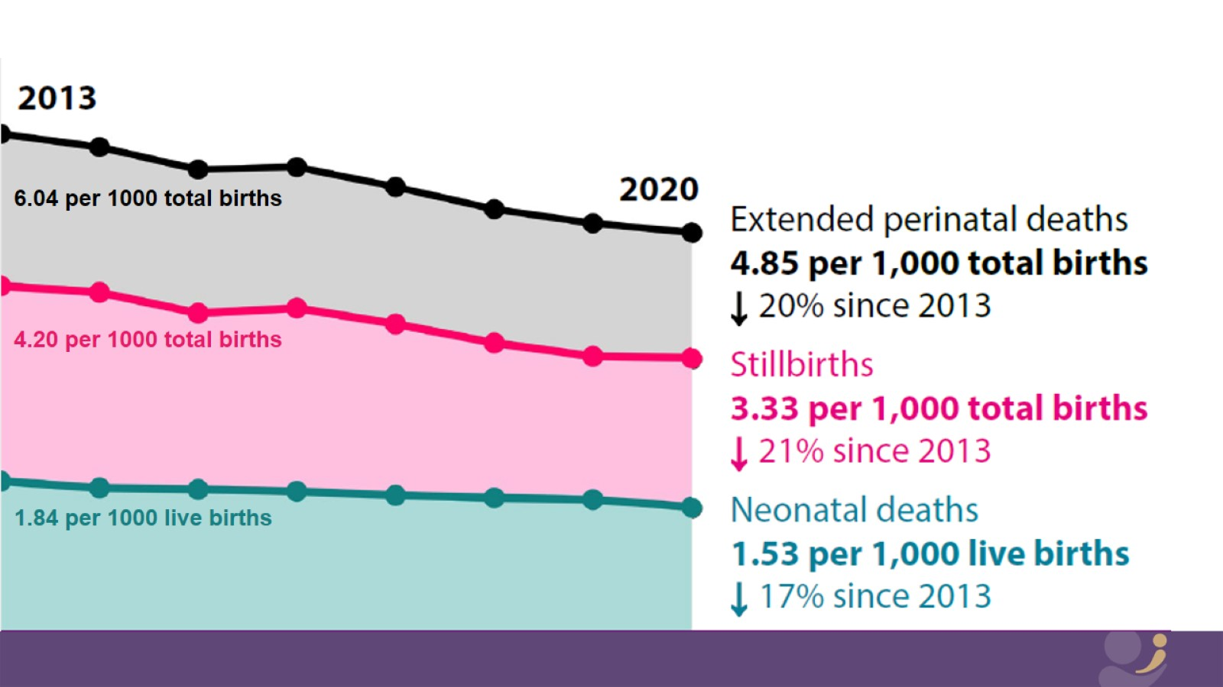

Slide 12
Perinatal mortality rates in the UK: 2020

Slide 13
Perinatal mortality rates in the UK: 2020

Slide 14
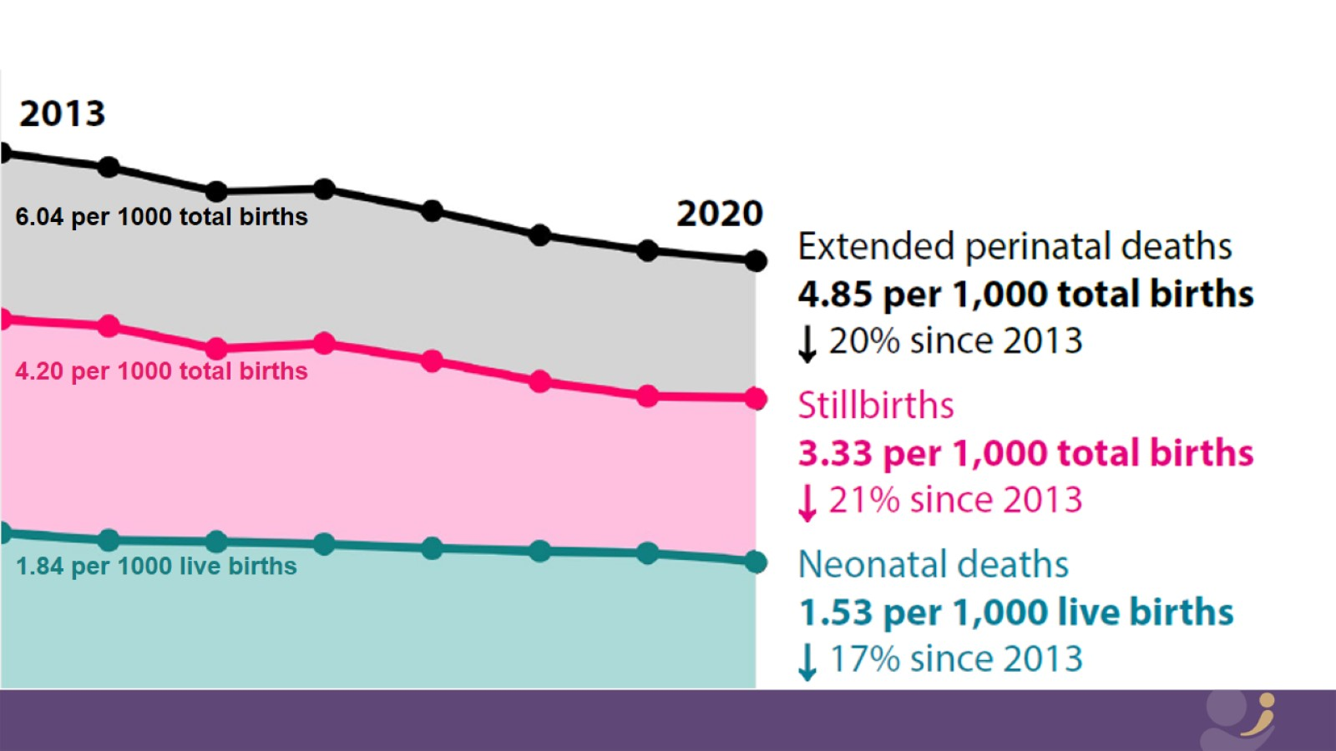

Slide 16
Perinatal mortality rates in the UK: 2020

